Slide 1
AGENDA
HTML + CSS
JavaScript + NodeJS
ECMScript 6
Functioneel programmeren

Slide 2

Recommended Site
https://www.freecodecamp.org/news/a-practical-guide-to-learning-front-end-development-for-beginners-da6516505e41/

Slide 3

HTML + CSS

Slide 4
Three Layers of the Web

Slide 5
Keep all of these 3 layers separate !
JavaScript in a .js-file
CSS styling in a .css-file
HTML in a .html-file

Slide 6
HTML + CSS
See:
https://www.w3schools.com/html
And:
https://www.internetingishard.com/html-and-css/basic-web-pages/

Slide 7
JavaScript - language

Slide 8
Requirements
Must have Node installed !
Must have Chrome installed
Use Visual Studio IDE

Slide 9
Agenda JavaScript
What is JavaScript
What is ECMAScript
JavaScript - the Basics

Slide 10
What is JavaScript
Go to:
w3schools.com

Slide 11
JavaScript
Object-oriented
Scripting language
Depends on Browser or Node to execute
Used to make webpages interactive.

Slide 12
JavaScript
Client-side
en
Server-side

Slide 13
Client-side
JavaScript can be executed by browsers
The browser extends JavaScript to:
Manipulate DOM (Data Object Model)
Interact with services from the browser

Slide 14
Server-side JavaScript
Executed by Node
Extended with objects to:
Interact with IO
Interact with Sockets

Slide 15
How is the browser extending JavaScript?
Web APIs: Browsers expose a wide range of APIs (DOM API, Audio API, GeoLocation API)
Promises and Async/Await
Web Components
ES6 and Beyond
WebAssembly
Notes:
Modern browsers are constantly extending JavaScript by implementing new features and APIs that enable developers to create more powerful and sophisticated web applications.
Some examples of browser extensions to JavaScript include:
Web APIs: Browsers expose a wide range of APIs (Application Programming Interfaces) that allow JavaScript code to interact with different parts of the browser and operating system. For instance, the DOM API allows JavaScript code to manipulate the document structure and content, the Fetch API enables network requests, and the Web Audio API lets developers create audio effects and music applications.
Promises and Async/Await: JavaScript now includes built-in support for Promises and Async/Await, which allow developers to write asynchronous code in a more intuitive and readable way.
Web Components: Browsers are adding support for Web Components, a set of standards for creating reusable UI components that can be used across different applications. Web Components enable developers to encapsulate their code, making it easier to build, test, and maintain large applications.
ES6 and Beyond: Browsers are also implementing new features from the latest version of JavaScript, such as arrow functions, template literals, classes, and modules. These features make it easier to write more concise and maintainable code.
WebAssembly: Browsers now support WebAssembly, a low-level binary format that enables developers to write high-performance code in languages other than JavaScript, such as C and C++. WebAssembly can be used to run computationally intensive tasks, such as video encoding and 3D rendering, in the browser.
Overall, these extensions to JavaScript enable developers to build more powerful, feature-rich, and responsive web applications that can run seamlessly across different devices and platforms.

Slide 16

HTML-DOM – tree of objects
Notes:
With the object model, JavaScript gets all the power it needs to create dynamic HTML:
JavaScript can change all the HTML elements in the page
JavaScript can change all the HTML attributes in the page
JavaScript can change all the CSS styles in the page
JavaScript can remove existing HTML elements and attributes
JavaScript can add new HTML elements and attributes
JavaScript can react to all existing HTML events in the page
JavaScript can create new HTML events in the page

Slide 17
The HTML DOM is a Programming Interface
for how to
get, change, add
or delete HTML elements

Slide 18
https://www.w3schools.com/js/js_htmldom.asp

Slide 19
How is the Node extending JavaScript?
Global objects: such as require, module, and process
Built-in modules: such as fs, http, events
CommonJS module system
Asynchronous I/O: The non-blocking Event Loop
Npm package manager for third-party modules
Notes:
Node.js is a JavaScript runtime built on the V8 JavaScript engine, and it extends JavaScript in several ways to enable server-side development. Some examples of how Node.js extends JavaScript are:
Global objects: Node.js provides additional global objects that are not available in browser-based JavaScript, such as require, module, and process. These objects provide functionality specifically designed for server-side development, such as module loading, file system access, and process management.
Built-in modules: Node.js includes a rich set of built-in modules that provide a wide range of functionality for server-side development, such as fs for file system operations, http and https for building HTTP and HTTPS servers, crypto for cryptographic operations, and events for working with event-driven programming.
CommonJS module system: Node.js uses the CommonJS module system, which allows developers to create and organize their code as modules that can be easily imported and used in other parts of the application. This module system provides a way to structure and manage large-scale applications, making it suitable for server-side development.
Asynchronous I/O: Node.js is designed to be highly scalable and performant, and it uses asynchronous I/O to handle large numbers of simultaneous connections efficiently. This is done through features such as callback functions, event-driven programming, and the Node.js Event Loop, which allows developers to write non-blocking I/O code that can handle multiple requests concurrently without blocking the main thread.
Child processes: Node.js allows for the creation and management of child processes, which enables developers to run external processes or scripts from within Node.js applications. This allows for tasks such as spawning new processes, running shell commands, and interacting with other programs, which is particularly useful for tasks such as system administration, automation, and background processing.
NPM (Node Package Manager): NPM is a package manager that comes with Node.js, which provides a vast ecosystem of third-party modules that can be easily installed and used in Node.js applications. This extends the functionality of JavaScript in Node.js by allowing developers to leverage a wide range of pre-built modules to solve common development tasks, such as database access, authentication, and logging.
Overall, Node.js extends JavaScript by providing additional functionality, modules, and tools specifically tailored for server-side development, making it a powerful platform for building scalable and high-performance server-side applications using JavaScript.
Regenerate response

Slide 20
ECMAScript

Slide 21
ECMAScript
Netscape asked Ecma International to create JavaScript specification
Started in 1996, first release in 1997
Notes:
ECMA = European Computer Manufacturers Association

Slide 22
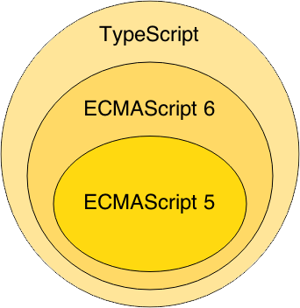

Slide 23
JavaScript
The Basics

Slide 24
Starting point:
MDN Web docs
https://developer.mozilla.org/

Slide 25
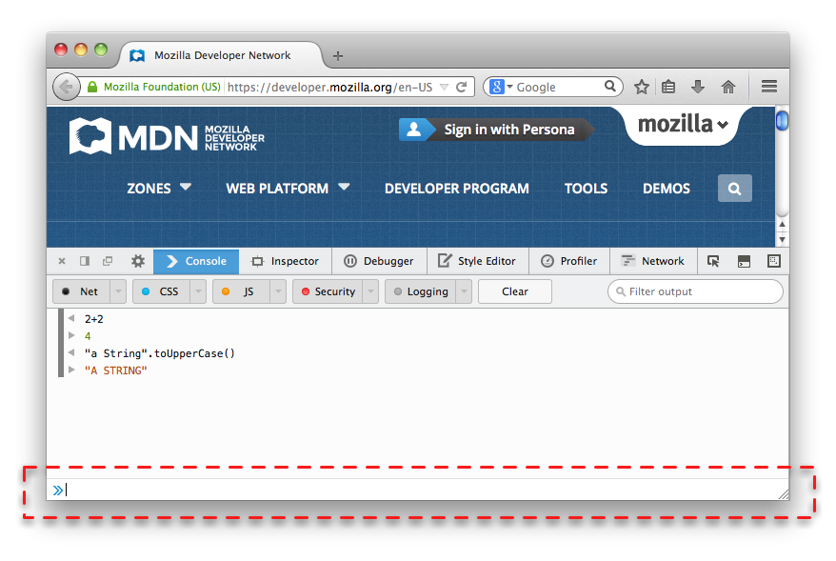
Browser Console
Internet Explorer F12
Firefox Ctrl + Shift + J
Chrome - View > Developer > JavaScript Console
Notes:
Nearly every browser can run JavaScript and most modern browsers now include a JavaScript console that can be used to run snippets of JavaScript code.

Slide 26
Your First JavaScript Program
Type the following in your Browser Console:
console.log("Hello World!");

Slide 27
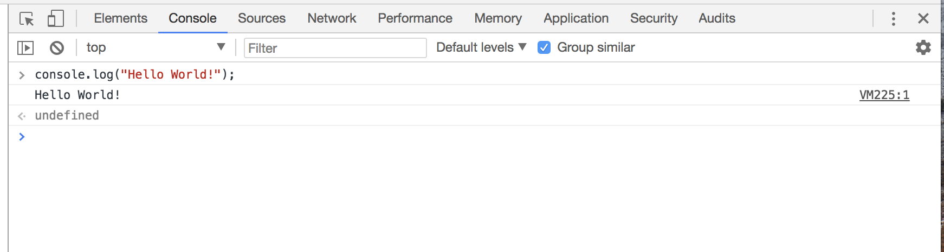

Slide 28
Three Layers of the Web

Slide 29
Keep all of these 3 layers separate !
JavaScript in a .js-file
CSS styling in a .css-file
HTML in a .html-file

Slide 30
Hello world example
https://plnkr.co/edit/?p=preview&preview

Slide 31
Important Guides JS
https://javascript.info/
https://developer.mozilla.org/nl/

Slide 32
Tutorial
https://developer.mozilla.org/en-US/docs/Learn/Getting_started_with_the_web/JavaScript_basics

Slide 33
https://mdn.github.io/beginner-html-site-scripted/
DEMO Final solution !!!

Slide 34
First step
download
https://github.com/mdn/beginner-html-site-styled/archive/gh-pages.zip
Notes:
Calculator: http://embed.plnkr.co/YB9vnC/

Slide 35
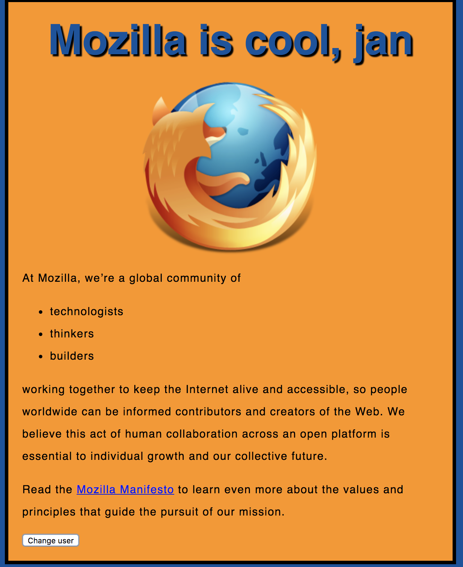
Notes:
https://mdn.github.io/beginner-html-site-scripted/

Slide 36
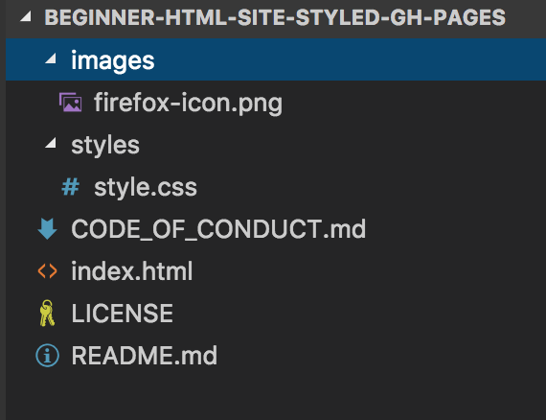

Slide 37
<!DOCTYPE html>
<html>
<head>
</head>
<body>
</body>
</html>
index.html

Slide 38
<!DOCTYPE html>
<html>
<head>
<meta charset="utf-8">
<title>My test page</title>
<link href="styles/style.css" rel="stylesheet" type="text/css">
</head>
<body>
<h1>Hello World!</h1>
<img src="images/firefox-icon.png">
</body>
</html>

Slide 39
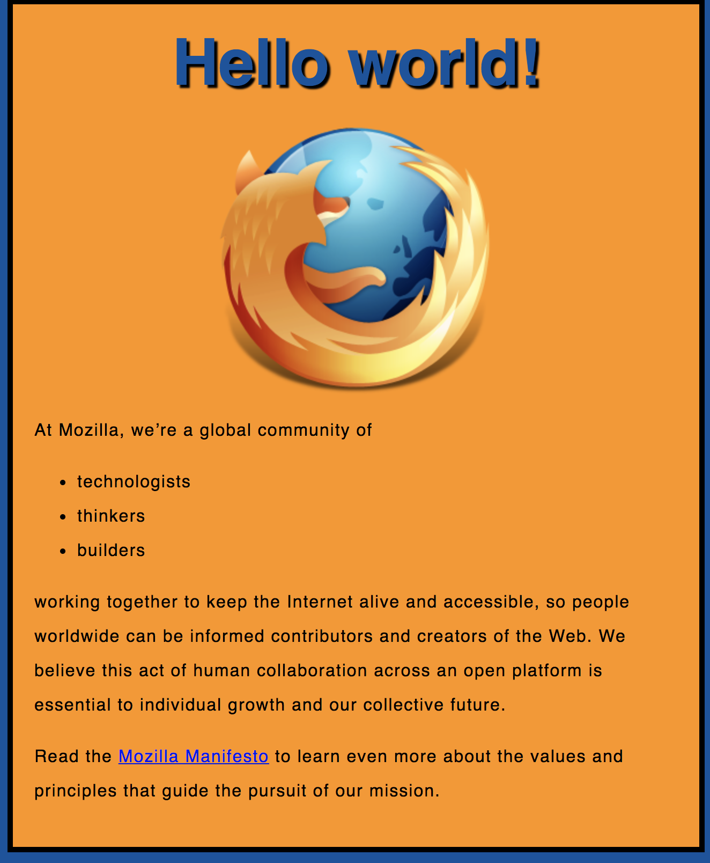
Exercise 1

Slide 40
Exercise 1
Create a new file called main.js
Save it in your scripts folder.

Slide 41
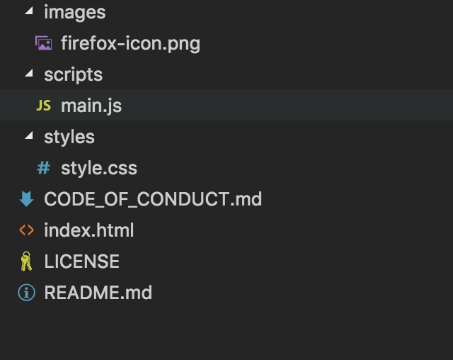

Slide 42
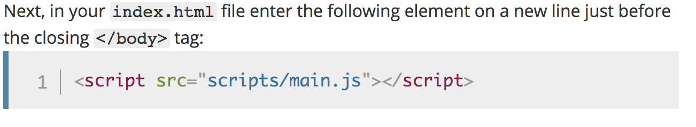
Notes:
<script src="scripts/main.js"></script>

Slide 43
<!DOCTYPE html>
<html>
<head>
<meta charset="utf-8">
<title>My test page</title>
<link href="styles/style.css" rel="stylesheet" type="text/css">
</head>
<body>
<h1>Hello World!</h1>
<img src="images/firefox-icon.png" alt="The Firefox logo: a flaming fox.">
<script src="scripts/main.js"></script>
</body>
</html>
Notes:
Note: The reason we've put the <script> element near the bottom of the HTML file is that HTML is loaded by the browser in the order it appears in the file. If the JavaScript is loaded first and it is supposed to affect the HTML below it, it might not work, as the JavaScript would be loaded before the HTML it is supposed to work on. Therefore, putting JavaScript near the bottom of the HTML page is often the best strategy.

Slide 44
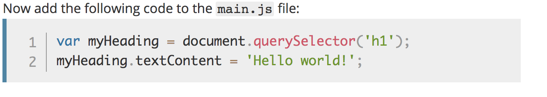
Manipulate HTML/DOM
Notes:
Note: Both of the features you used above are parts of the Document Object Model (DOM) API, which allows you to manipulate documents.
let myHeading = document.querySelector('h1');
myHeading.textContent = 'Hello world!';

Slide 46
Variables

Slide 47
Variables
var myVar = "foobar";

Slide 48
Variables
var a, b, c;
var a = 3;
var d = 10, e = 10;
f = 22;
var pi = 3.14159;
var s = 'a', t = "t";

Slide 49
Identifiers
Must start with either “$”, “_” or a letter
Subsequent letters can be “$”, “_”, letter, numbers
var 1abc = 3; // Invalid
var $123 = 3; // Valid
Notes:
Identifier = variabelenaam.

Slide 50
Types
“Primitive” value types:
Number (floating point)
String
Boolean
null
undefined
Notes:
null = NIL
undefined= niet geinitializeerd.

Slide 51
Built-in values
true & false
null
undefined
NaN (=Not A Number)
Infinity

Slide 52
Conditionals

Slide 53
Conditionals
if (expression1) {
//Executes when expression1 is truthy
} else if (expression2) {
//Executes when expression2 is truthy
} else {
//Executes when none of the above conditions are truthy
}

Slide 54
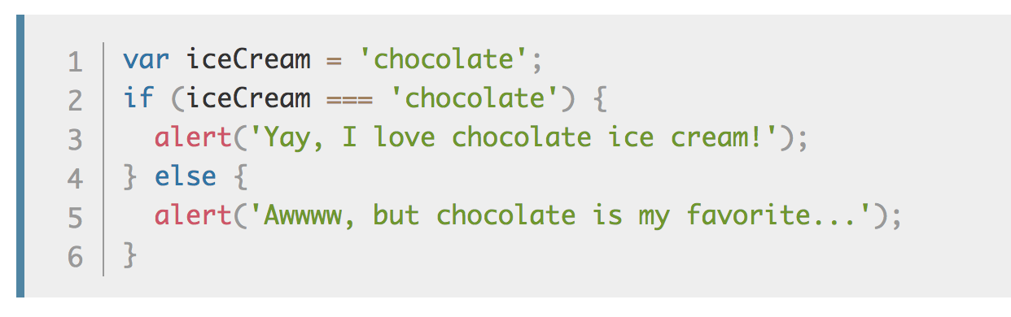
Conditionals

Slide 55
Truthy Falsy
Falsy values:
false, null, undefined, 0, ‘’, NaN
Truthy values:
Everything else

Slide 56
if (null) { // false
} else if (0) { // false
} else if ('') { // false
} else if (1) { // true
}

Slide 57
== vs ===
== performs type coercion
tries to match types for comparison
=== does NOT perform type coercion
will fail if type is different
Notes:
== Coercion: cast gelijk de datatypes.
===

Slide 58
Conditionals

Slide 59
Example
"" === 0 // false
"" == 0 // true
'0' == 0 // true
false == '0' // true
4 != '4' // false
4 !== '4' // true
Try to use ===, !==
instead of ==, !=

Slide 60
Infix operators same as Java
var x = 4;
if (x > 3 && x < 6) {
} else if (x > 3 || x === 2) {
}

Slide 61
Functions

Slide 62
Functions
Functions are objects
Can be created on their own (anonymous)
function foo() {
alert(“HOI”);
}
Can assigned to a variable
var x = function() {}

Slide 63
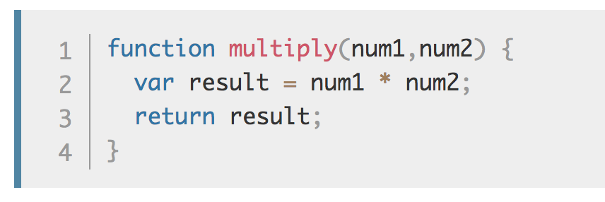
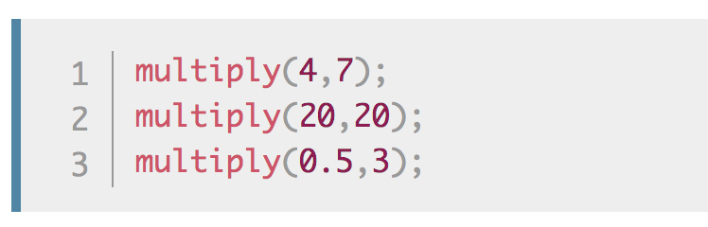
Make your own functions
Notes:
Note: The return statement tells the browser to return the result variable out of the function so it is available to use.
This is necessary because variables defined inside functions are only available inside those functions.
This is called variable scoping.

Slide 64
Events
Examples when Events are executed:
clicked on a button. onClick-event()
clicked on a page
pressed on enter-key

Slide 65
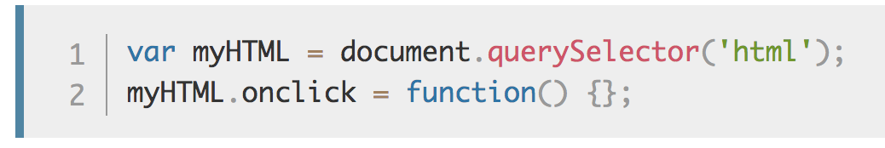
onclick Event

Slide 66
Use “let” or “const” instead of “var”
In modern JavaScript we have 3 ways to declare a variable and assign it a value:
var
let a= 5;
const STATIC1=“ik ben static”
Notes:
See: https://dev.to/mrmario/let-var-const-write-clean-and-safe-code-37hh
https://flaviocopes.com/javascript-difference-let-var/
Var function scoping. Var is a bit more weird, as it has function scoping, which means that variables declared using var are scoped to the nearest function.
Let is block scoping is safer. Niet bekend in de global scope

Slide 67
Let is block scoped
https://www.w3schools.com/js/js_let.asp
https://developer.mozilla.org/en-US/docs/Web/JavaScript/Reference/Statements/let

Slide 68
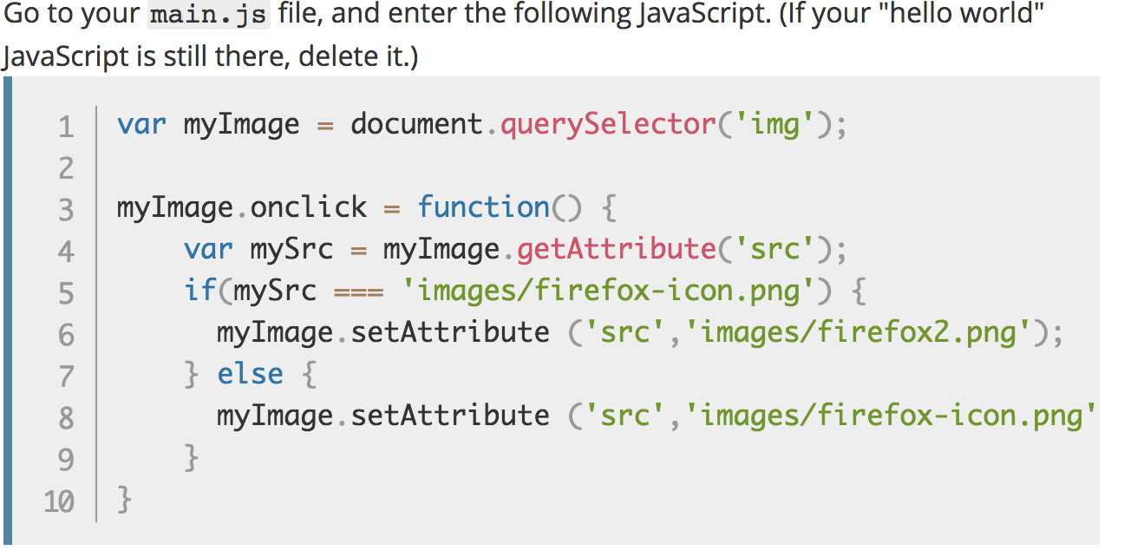
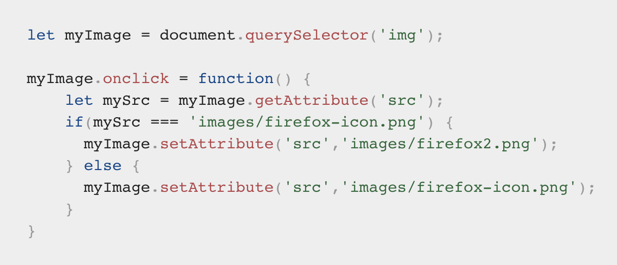
Exercise 2
Notes:
You store a reference to your <img> element in the myImage variable. Next, you make this variable's onclick event handler property equal to a function with no name (an "anonymous" function). Now, every time this element is clicked:
let myImage = document.querySelector('img');
myImage.onclick = function() {
let mySrc = myImage.getAttribute('src’);
if(mySrc === 'images/firefox-icon.png') {
myImage.setAttribute ('src','images/firefox2.png’);
} else {
myImage.setAttribute ('src','images/firefox-icon.png’);
}
}

Slide 69
Exercise 3
Adding a personalized welcome message

Slide 70
Notes:
https://mdn.github.io/beginner-html-site-scripted/

Slide 71
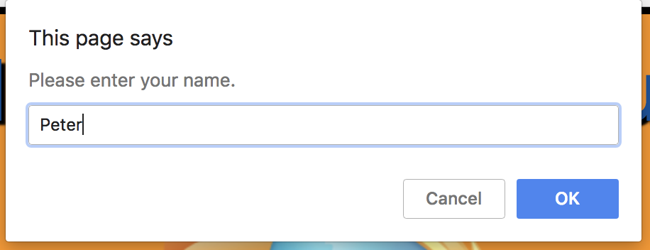

Slide 72
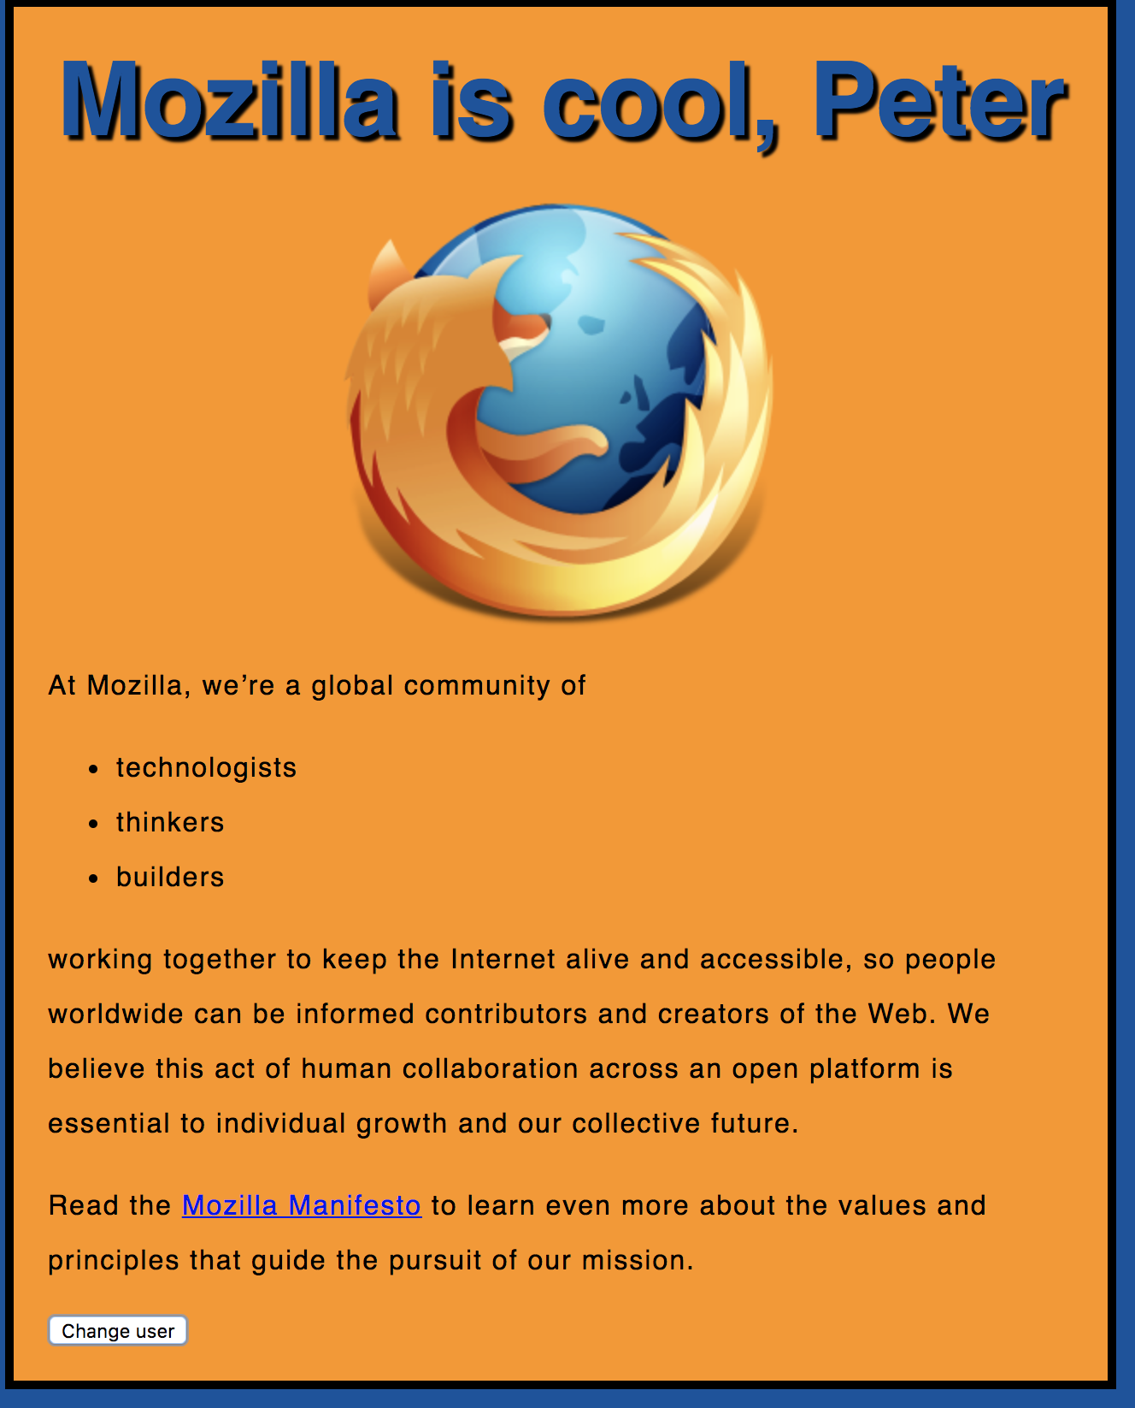

Slide 73
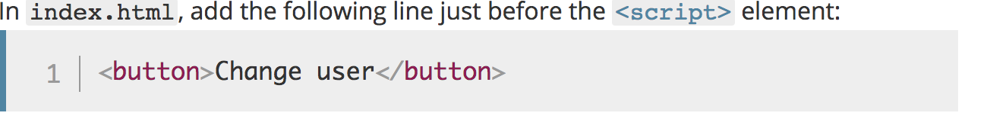

Slide 74
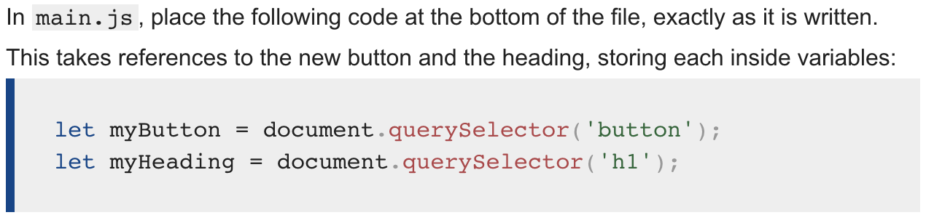
Notes:
let myButton = document.querySelector('button’);
let myHeading = document.querySelector('h1');

Slide 75
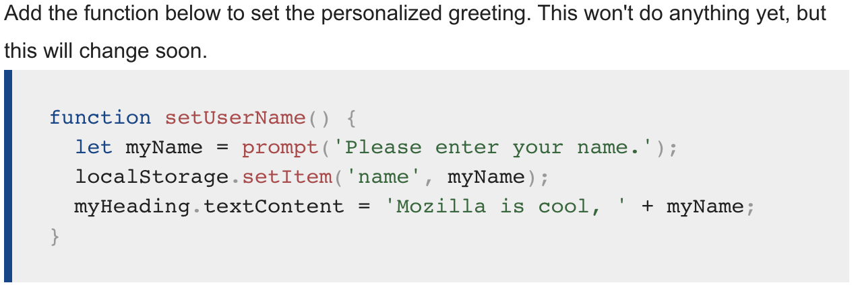
Notes:
function setUserName() {
let myName = prompt('Please enter your name.');
localStorage.setItem('name', myName);
myHeading.innerHTML = 'Mozilla is cool, ' + myName;
}

Slide 76
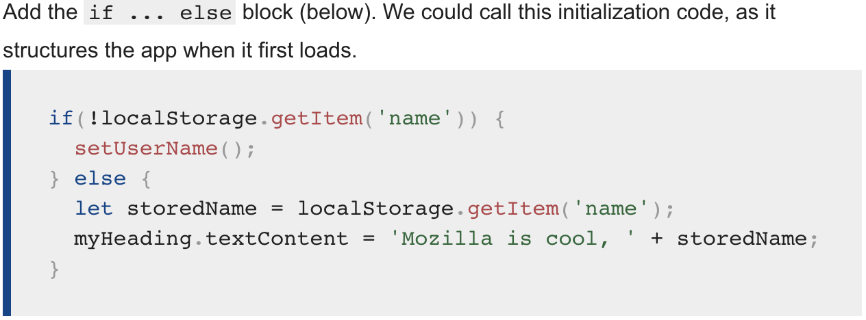
Notes:
if(!localStorage.getItem('name')) {
setUserName();
} else {
let storedName = localStorage.getItem('name');
myHeading.innerHTML = 'Mozilla is cool, ' + storedName;
}

Slide 77
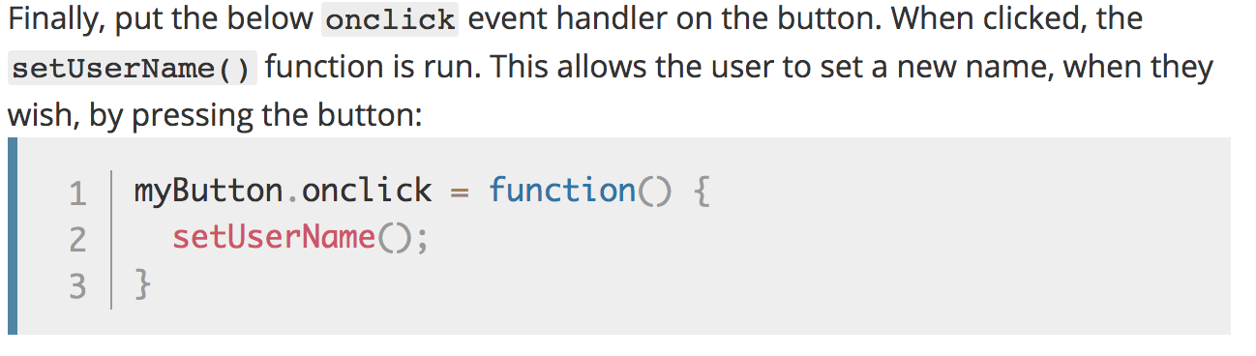
Notes:
myButton.onclick = function() {
setUserName();
}

Slide 78
Solution
https://github.com/mdn/beginner-html-site-scripted

Slide 79
Iterators/ Loops

Slide 80
Iterators
while (expression) { .. }
for (let i=0; i < cars.lenght; i++) { .. }
for (variable of object) { .. }
for (variable in object) { .. }

Slide 81
for of
The for of - statement
loops through the values of an iterable object.

Slide 82
for of
const cars = ["BMW", "Volvo", "Mini"];
let text = "";
for (let x of cars) {
text += x + "<br>";
} // BMW Volvo Mini

Slide 83
for in
The for in - statement
loops through the properties of an Object:

Slide 84
const person = {fname:"John", lname:"Doe", age:25};
let txt = "";
for (let x in person) {
txt += person[x] + " ";
} // John Doe 25

Slide 85
let list = [4, 5, 6];
for (const in list) { console.log(i); // "0", "1", "2" }
for (const i of list) { console.log(i); // "4", "5", "6" }

Slide 86
Arrays

Slide 87
Arrays
let beers = ['Heineken', 'Amstel', 'Jupiler’];
let cars = new Array("Saab", "Volvo", "BMW");
console.log(beers.length); // output is 3
let x = beers[0]; // x => 'Heineken'

Slide 88
Arrays
let beers = ['Heineken', 'Amstel', 'Jupiler'];
beers[5] = 'Palm';
console.log(beers.length); // output is 6 (!)
console.log(beers[3]); // output is undefined (!)
beers = [ , 'Heineken', , 'Amstel'];
console.log(beers.length); // output is 4 (!)

Slide 89
Objects

Slide 90
Objects
let car = new Object();
car.make = 'Ford';
car.model = 'Mustang';
car.year = 1969;

Slide 91
Associative Array /
Dictionary
let car = new Object();
car['make'] = 'Ford';
car['model'] = 'Mustang';
car['year'] = 1969;

Slide 92
JSON
let car = {
make: 'Ford’,
model: 'Mustang’,
year: 1969
};

Slide 93
JSON

Slide 94
JSON
JavaScript Object Notation
A common use of JSON is:
to exchange data to/from a web server.

Slide 95
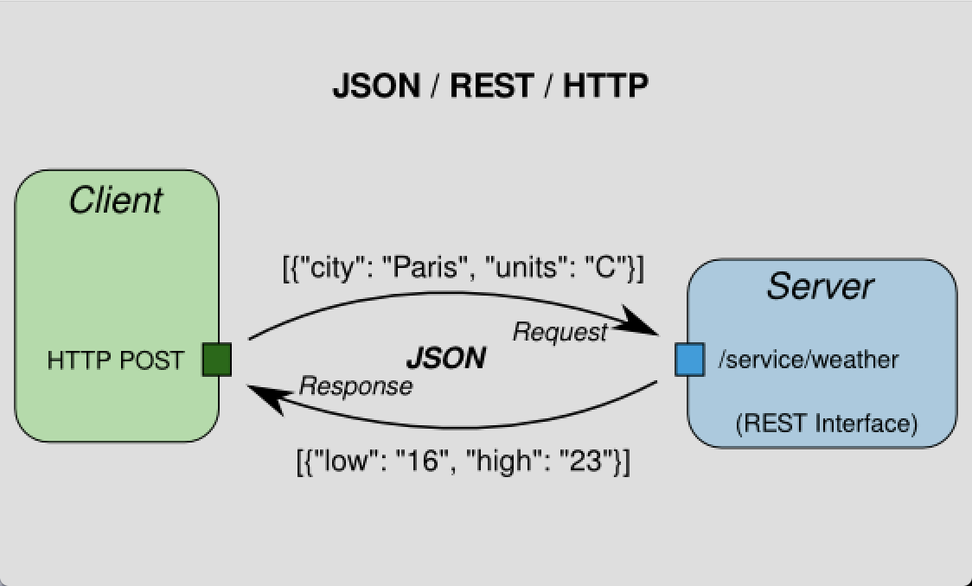

Slide 96
Valid JSON
let obj = {
"name":"John",
"age":30,
"city":"New York”
};

Slide 97
JSON
For parsing use:
var json = JSON.parse('{..}')
var jsonString = JSON.stringify({..});
Notes:
PARSE:
When receiving data from a web server, the data is always a string.
Parse the data with JSON.parse(), and the data becomes a JavaScript object.
STRINGIFY:
When sending data to a web server, the data has to be a string.
Convert a JavaScript object into a string with JSON.stringify().

Slide 99
JSON.parse( )
Parse the data with JSON.parse(), and the data becomes a JavaScript object.
See: https://www.w3schools.com/js/js_json_parse.asp

Slide 100
JSON.stringify( )
Convert a JavaScript object into a string with JSON.stringify().
See: https://www.w3schools.com/js/js_json_stringify.asp

Slide 101
Debugging in Chrome

Slide 102


Slide 103
Node.js provides a JavaScript runtime environment

Slide 104
Goals
Provide a JavaScript runtime environment
Event-driven, non-blocking I/O
fast/lightweight

Slide 105
Applications
Can be used to create Tools, applications or services
Powered by Chrome’s V8 JavaScript engine
npm, package ecosystem

Slide 106

History
First written in 2009
By Ryan Dahl
2010 package manager npm
2011 native Windows version

Slide 107
Utilities
Node comes with the following:
I/O, Sockets(http/dns/udp/etc), crypto functions, data streams
Runs on Linux, Mac, Windows

Slide 108
Opdracht Node
Open map:
2- Node
Opdracht:
Implement a directory walker

Slide 109
Opdracht Node
How to read recursively a directory in Node.js

Slide 110
Readme
Open Readme for instructions

Slide 111
Package.json
Package.json is important for NPM.
With this file you can declare all your dependencies and install them.

Slide 112
Step 1
Open your prompt/shell/terminal in the root directory
and type: `npm install --save filewalker`

Slide 113
What is generated
A couple of things have happened:
NPM installed the `filewalker` dependency locally in the node_modules folder
NPM add `filewalker` to the dependency list in package.json

Slide 114
Great!
This means that we are now able to use this dependency.

Slide 115
Step 2 Use the dependency
Open:
`nodeScript.js`

Slide 116
First we need to require the dependency.
Add the following in your nodeScript:
const filewalker = require('filewalker');

Slide 117
Step 3
Using the following code we can traverse a directory:
filewalker('A_DIRECTORY')
.on('dir', p => console.log('dir: %s', p))
.walk();

Slide 118
Step 4 Execute script
node nodeScript.js

Slide 119
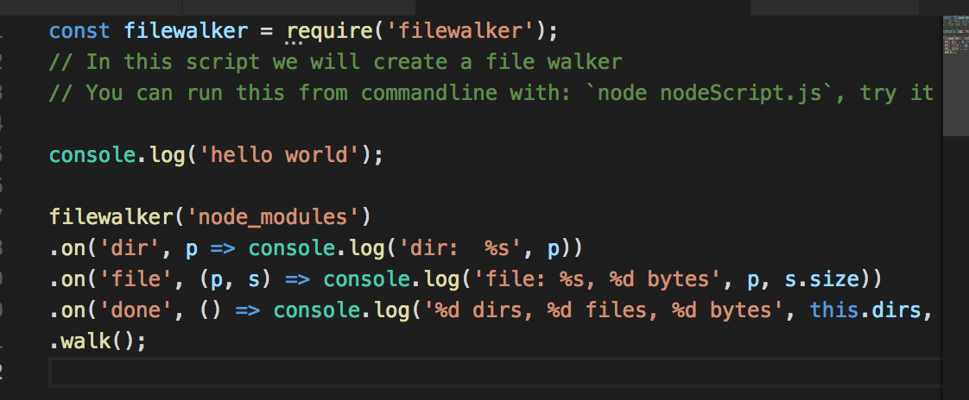
Notes:
filewalker('node_modules')
.on('dir', p => console.log('dir: %s', p))
.on('file', (p, s) => console.log('file: %s, %d bytes', p, s.size))
.on('done', () => console.log('%d dirs, %d files, %d bytes', this.dirs, this.files, this.bytes))
.walk();

Slide 120
Exercise create REST-API
https://www.codementor.io/wapjude/creating-a-simple-rest-api-with-expressjs-in-5min-bbtmk51mq

Slide 121
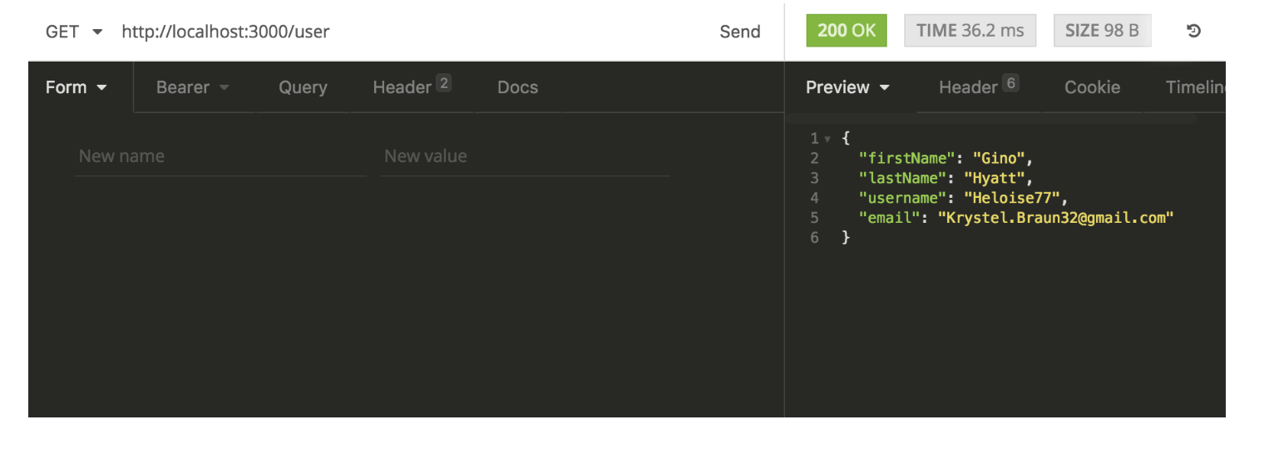

Slide 122
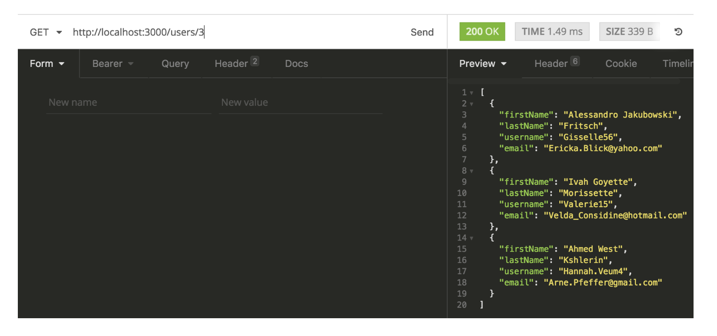

Slide 123
Building blocks
Node.js
ExpressJS: for REST API
body-parser
Faker: generate random user account details

Slide 124
Async Programming
Notes:
Voorbeeld Whatsapp. Async communcatie met messaging.
Why Axios?

Slide 125
What is HTTP?
HTTP works as a request-response protocol between a client and server.
Notes:
A web browser may be the client, and an application on a computer that hosts a web site may be the server.
Example: A client (browser) submits an HTTP request to the server; then the server returns a response to the client. The response contains status information about the request and may also contain the requested content.

Slide 126
HTTP Methods
GET
POST
PUT
HEAD
DELETE
PATCH
OPTIONS

Slide 127
GET Method
GET is used to request data from a specified resource over HTTP.

Slide 128
POST Method
POST is used to send data to a server to create/update a resource.

Slide 129
PUT is idempotent
https://developer.mozilla.org/en-US/docs/Glossary/Idempotent
Notes:
An idempotent method means that the result of a successful performed request is independent of the number of times it is executed.

Slide 130
HTTP Request Methods
https://www.w3schools.com/tags/ref_httpmethods.asp

Slide 131
Exercise

Slide 132
Sync vs Async Programming
Notes:
Voorbeeld Whatsapp. Async communcatie met messaging.
Why Axios?

Slide 133
Async Programming
By sending asynchronously, the JavaScript does not have to wait for the server response, but can instead:
execute other scripts while waiting for server response
deal with the response after the response is ready

Slide 134
Promise Syntax
Service.get()
.then(x => console.log(x)) → onsucces
.catch(error => console.log(error)) → onerror

Slide 135
Async with AXIOS
Promise based HTTP client for the browser

Slide 136
CORS
Cross-Origin Resource Sharing (CORS) is a technique for relaxing the same-origin policy, allowing Javascript on a web page to consume a REST API served from a different origin.

Slide 137
CORS

Slide 138
CORS
Notes:
This mechanism prevents attackers that plant scripts on various websites (eg. in ads displayed via Google Ads) to make an AJAX call to www.yourbank.com
and in case you were logged in making a transaction using *your* credentials.

Slide 139
Exercise Full stack 1 + 2
https://itnext.io/learn-how-full-stack-apps-work-by-building-a-simple-one-using-javascript-part-1-38e237694012
https://
Notes:
https://codeburst.io/build-a-weather-website-in-30-minutes-with-node-js-express-openweather-a317f904897b

Slide 140
configure the CORS
see: www.npmjs.com/package/cors

